Slide 1
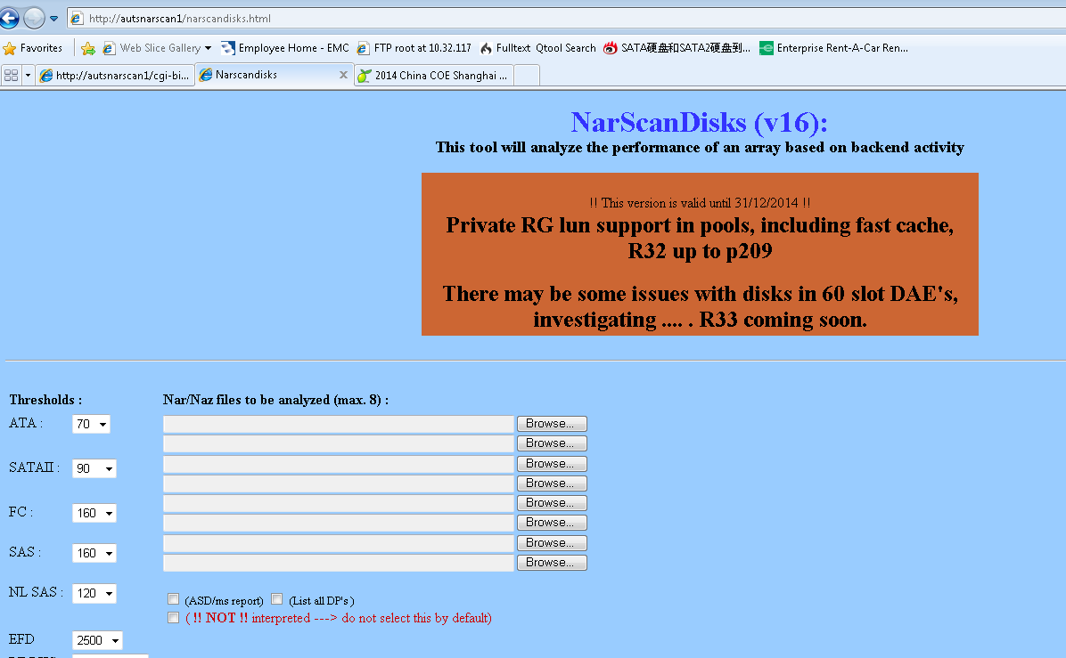
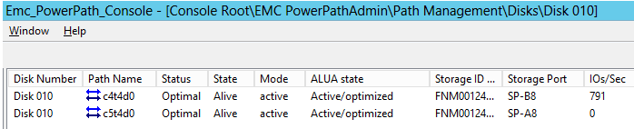
NARscandisks
Installation Path:
http://autsnarscan1/narscandisks.html use online version or just download the *.exe
Comments:
It is a great tool to help engineer to analysis performance related issue more efficiently. It can scan out the general performance issue very quickly, like: disk overloaded, force flushing, queue full, BE bandwidth overload, and etc. After using this tool, you can check the NAR file in details in Unisphere more specifically.
Details:
http://autsnarscan1/narscandisks.html
Demo:
NARscandisk0.wrf

Slide 2
Perf_trace
Installation Path:
The Perf_trace tool can be found on the SPEED website. It can be downloaded directly from the menu bar on SPEED - Tools -> Resources/Tools/Links.
Note: Only CSPEED members have access to this tool on the SPEED website.
Comments:
PERF_trace is a tool which automates the collection of RBA traces. This tool is only available for CLARiiON arrays running Release 29 and higher. For arrays running an older Flare code you must still collect these RBA traces manually by connection to the SP via emcremote.
Details:
PERF_trace User Manual.pdf
Demo:
Perf_trace.wrf

